Slide 1
Classifying Song Genres
Mini Project 1 by Abhinav Pandey

Slide 2

Dataset
Source - The Million Song Dataset was compiled by Echo Nest and the subset used in this project are available on the DataCamp website.
About :
Contains 4800 songs with genre labels “Hip-Hop” and “Rock”.
Another dataset that has musical features of each song on a scale from -1 to 1. They are -
danceability,
acousticness,
energy,
instrumentalness,
liveness,
speechiness,
tempo
valence

Slide 3
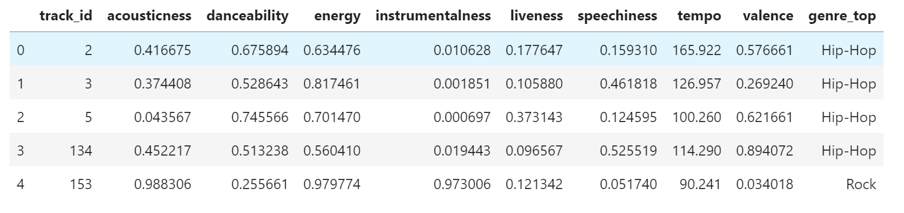
Dataset

Slide 4
Steps
Exploratory Data Analysis
Down-sampling to Balance Classes
Normalizing the Data
Dimensionality Reduction (PCA)
Classification
Decision Tree
Logistic Regression
Model Evaluation and Cross-Validation

Slide 5
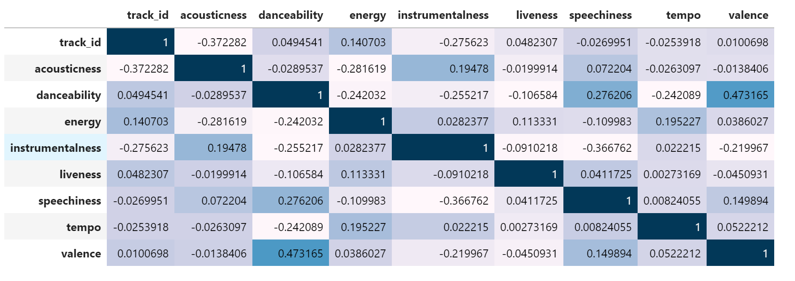
Exploratory Analysis
Correlation among continuous variables.
We do this to identify and remove redundant features.
No significant correlations! So we will try PCA for feature reduction.

Slide 6
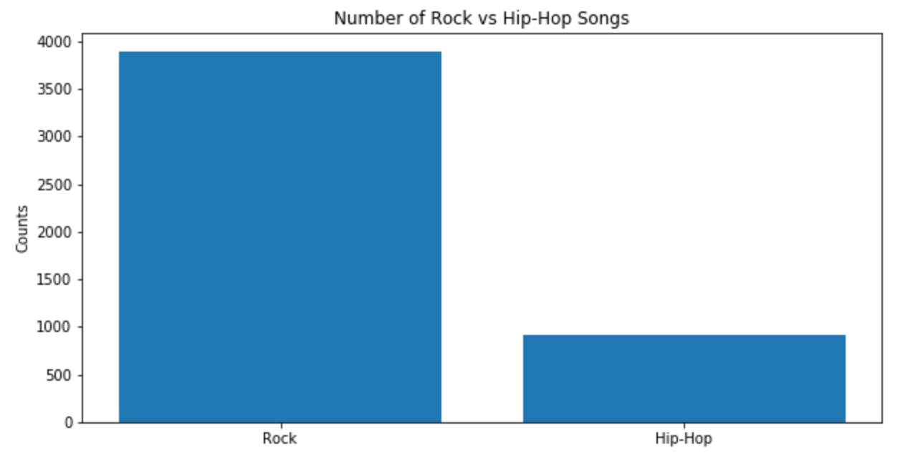
Exploratory Analysis
2. Number of Hip-Hop Songs
Vs Rock Songs
Unbalanced Data

Slide 7
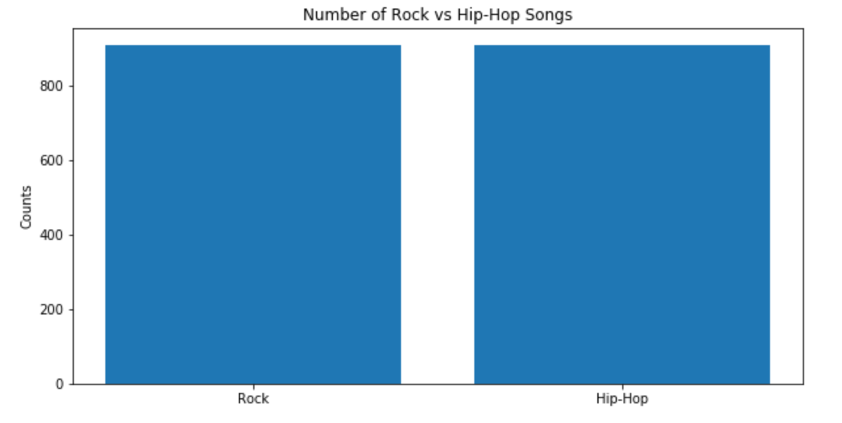
Downsampling for Balancing Dataset
Data after balancing

Slide 8
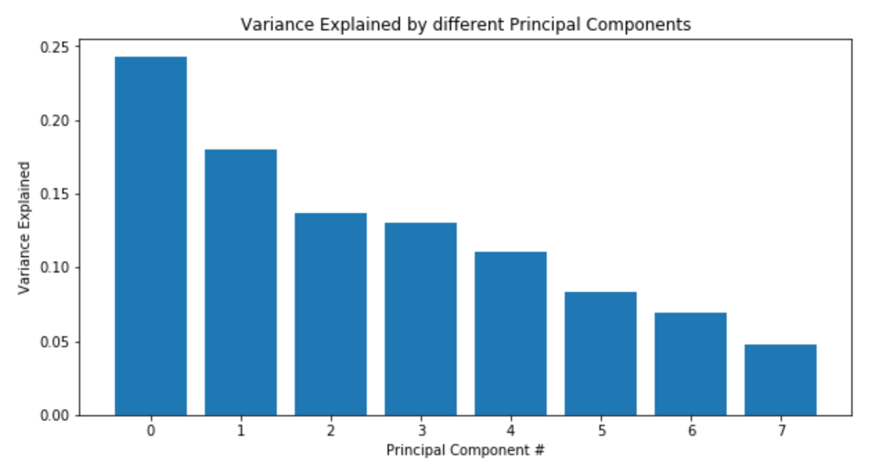
Principal Component Analysis (PCA)
Use PCA to make simple and computationally faster model.
The plot shows the variance in the data explained by each Principal Component.
In order to select the right number of Principal Components we will set a threshold and plot the Cumulative Explained Variance by all the components.

Slide 9
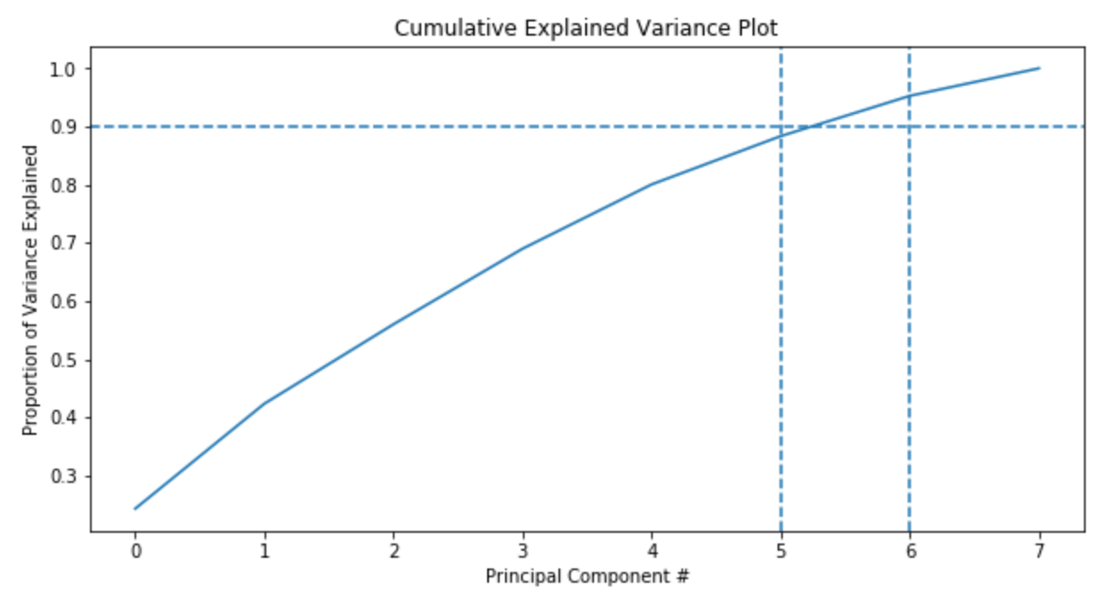
Principal Component Analysis (PCA)
The plot the shows the Cumulative Explained Variance Ratio the Principal Components of our data.
Threshold = 90%
N components for PCA = 6

Slide 10
Classification Results
Model Name | Precision | F1 Score | Test Accuracy | Cross-Validation Accuracy
Decision Tree | 0.74 | 0.74 | 74.02% | 74.89%
Logistic Regression | 0.82 | 0.82 | 82.46% | 78.29%
Logistic Regression performs better for all metrics!

Slide 11
Future Work
Use different methods for modelling, such as SVC or Ensemble methods like Random Forest.
Use different preprocessing techniques.
Feature Engineering to create more meaningful features.

Slide 12


Thank You

